Slide 1
Starter Unit~ Unit 2
Review-1

Slide 2
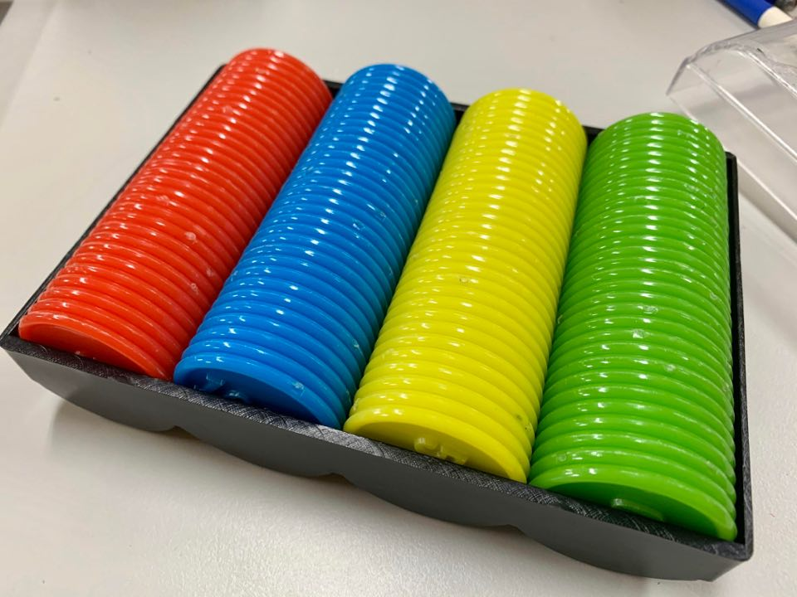
Get your CHIPS ready…
One chip for each color!

Slide 3
Question 1.
請依序排出:
Adam / Iris/ Peggy / Eddy

Slide 4
Question 2.
rainy What’s How’s yummy
_____ the weather?
It’s _____ and cold.

Slide 5
Question 3.
bikes cheese chair bakes
Sam ____ a _____ cake.

Slide 6
Question 4.
pin kid kite need
They _____ a _____ for the _____.

Slide 7
Question 5.
12 20 7 11
請仔細聽… 數字順序!

Slide 8
Question 6.
45 30 13 55
請仔細聽… 數字順序!

Slide 9
Question 7.
time it? is What
排出正確句子!

Slide 10
Question 8.
five now. It’s o’clock
排出正確句子!

Slide 11
Question 9.
What Mandy is doing?
排出正確句子!

Slide 12
Question 10.
is writing. She writeing.
排出正確句子!

Slide 13
Question 11.
is doing are jumping
What ____ they _____?
They are _____.

Slide 14
Question 12.
Are swiming is swimming
What ____ Pikachu doing?
It’s _____.

Slide 15
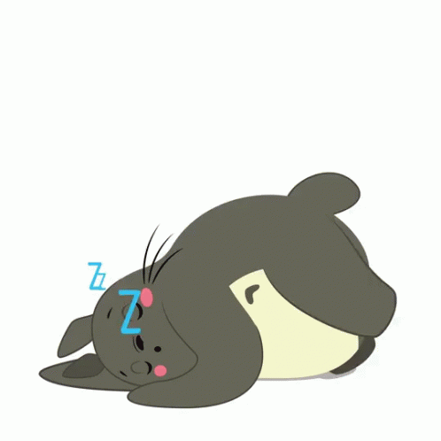
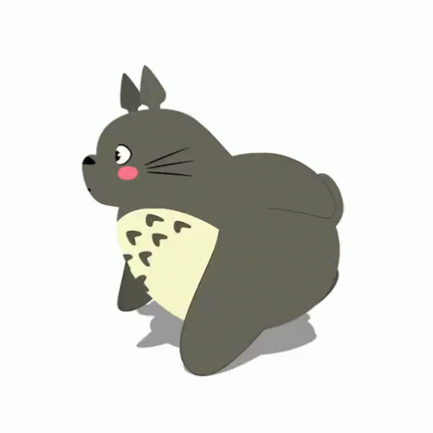
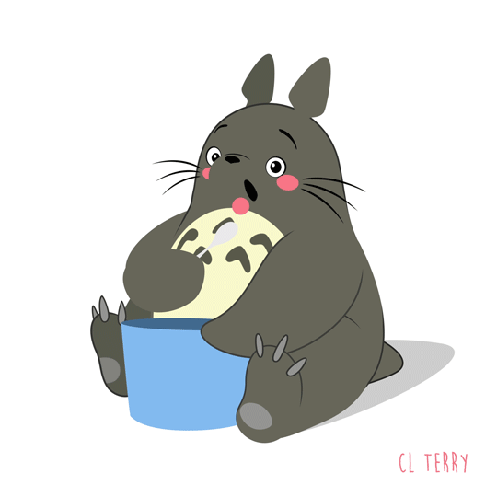
Question 13.
按照圖片的順序由左向右排單字
eating running dancing sleeping

Slide 16
Question 14.
It’s ____________.
five forty-five fifty-five o’clock

Slide 17
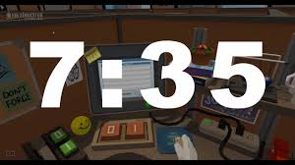
Question 15.
It’s ____________.
seven eleven thirty forty
-five -five

Slide 18
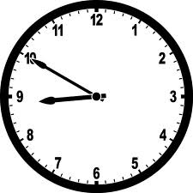
Question 16.
It’s ________.
six six
fifteen fifty
It’s ________.
eight eight
fifteen fifty

Slide 19
Question 17.
It’s ____________.
three three
seven oh seven

Slide 20
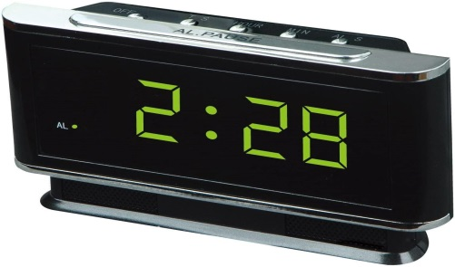
Question 18.
It’s ____________.
two two
twenty-eight thirty-eight

Slide 21
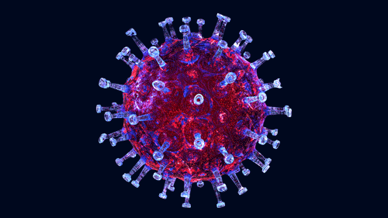
Question 19.
冠狀病毒的英文是…
cardinal corona virus vapor

Slide 22
Question 20.
隔離的英文是…
close quit question quarantine

Slide 23
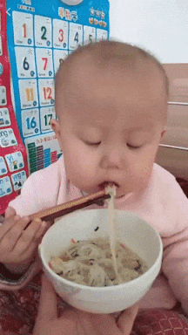
Question 21.
The baby eats with _________.
spoon chopsticks fork knife

Slide 24
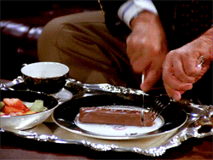
Question 22.
He eats with _________.
fork hand knife chopsticks

Slide 25
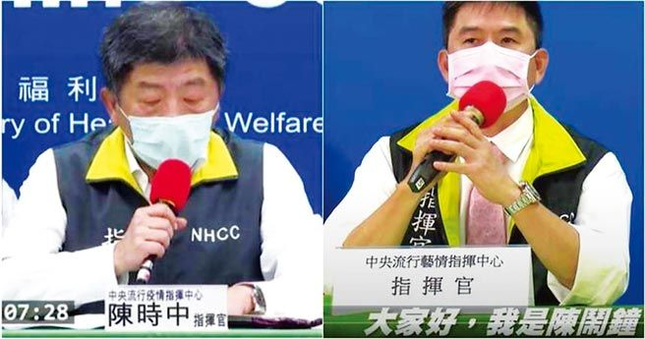
Question 21.
I am 陳鬧鐘. = ____ 陳鬧鐘.
 You are 陳時中, right?
= ______ 陳時中, right?
I’m I’am You’re Your

Slide 26
Question 23.
___ ___ Donald Trump.
= He’s Donald Trump.
 She is Tsai Ing-Wen.
= _____ Tsai Ing-Wen.
She’s We’re He is

Slide 27
Question 24.
I can not drink coffee.
= I _____ drink coffee.
 Do not go there.
= _____ go there.
ain’t can’t Didn’t Don’t

